Slide 1
Software engineering (Undergraduate)
Chapter 3 Requirements engineering
Course Name software engineering
CSC 3114
(Undergraduate)
Jubayer ahamed
Lecturer, CS, AIUB
jubayer@aiub.edu

Slide 2
Table of Contents
Introduction to Requirements in Software Engineering
Types of Software Requirements
Requirements Engineering Phases
Challenges in Requirements Engineering
Impact of Poor Requirements on Software Projects
Boehm’s Law
User Stories vs SRS
The Requirements Baseline
Definition of Shift Left Testing

Slide 3
Introduction to Requirements in SE
The software requirements are description of features and functionalities of the target system.
A condition or capability needed by a user to solve a problem or achieve an objective, or a condition or capability that must be met or possessed by a system or system component.
Essentially, requirements specify what the software must do, how well it must perform and any constraints it must adhere to.
For software projects to be successful, the Software Development Life Cycle (SDLC) is essential.

Slide 4
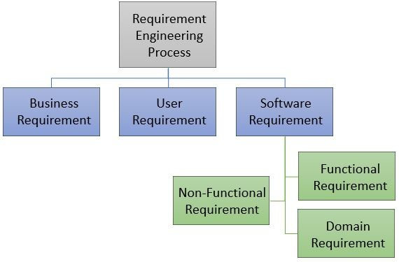
Figure 1: Types of requirements in RE

Slide 5
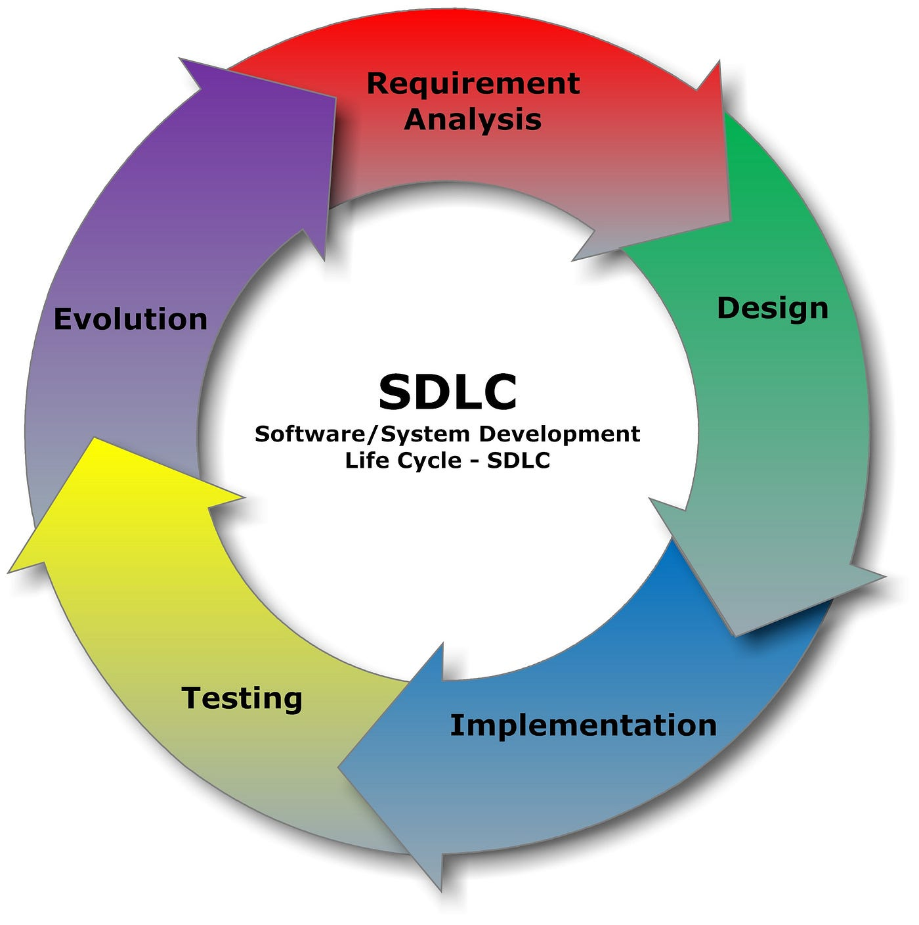
Role of Requirements in SDLC
Initial phase of project planning.
Basis for project estimation and planning.
Guides design, implementation, testing and maintenance.
SDLC offers an organized method that guarantees effectiveness, quality and risk reduction all the way through the development process.
Teams may satisfy client expectations, manage projects more effectively and produce dependable software by conforming to a specified SDLC.
Figure 2: SDLC Phases

Slide 6
User Needs vs. System Requirements
User Needs | System Requirements
1. High-level goals or expectations of the user. | 1. Detailed technical specifications the system must fulfill.
2. Described from the user's point of view. | 2. Described from the developer's or system designer's perspective.
3. Broad and general. | 3. Specific, measurable and testable.
4. To understand what users want or expect. | 4. To guide system design, development and testing.

Slide 7
Business vs. Technical Requirements
Business Requirements | Technical Requirements
1. High-level goals that the organization wants to achieve. | 1. Specific technical solutions to meet business requirements.
2. What the business needs. | 2. How the system will fulfill those needs.
3. Defined by business stakeholders (e.g., clients, managers). | 3. Defined by technical team (e.g., developers, architects).
4. Increase online sales by 20%, reduce processing time. | 4. Use of a secure payment gateway, implementation of necessary APIs.

Slide 8
Functional Requirements and Non-Functional Requirements
FR defines system behavior and functions.
Example: “System must allow users to log in”.
NFR defines system attributes like performance, usability.
Often affect user satisfaction.

Slide 9
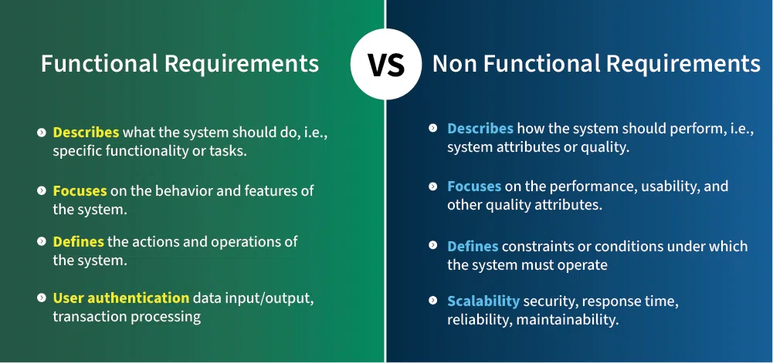
Functional Requirements and Non-Functional Requirements [Cont.]

Slide 10
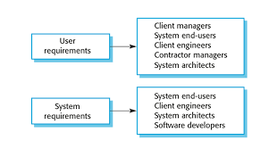
User, System and Business Requirements
User: What users expect to do.
System: Detailed technical description.
Business: Alignment with business goals. From a business standpoint, business requirements specify what the software system must do in order for the company to reach its objectives.

Slide 11
Examples of Critical NFRs
NFR Category | Example
Performance | The system shall handle 1000 transactions per second.
Reliability | The system shall have 99.99% uptime over a 12-month period.
Scalability | The system shall support up to 10,000 concurrent users without failure.
Security | All user data shall be encrypted using AES-256 during transmission.
Usability | New users shall be able to learn to use the system within 30 minutes.
Notes:
"AES-256": Stands for Advanced Encryption Standard with a 256-bit key, which is a strong, industry-standard encryption method used to secure data.

Slide 12
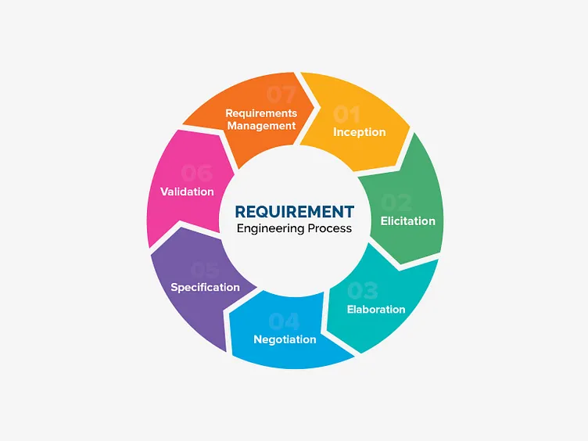
Requirements Engineering Phases
The phases are:
Inception
Elicitation
Elaboration
Negotiation
Specification
Validation
Req. Management
Cyclical and iterative process
Figure 3: RE Phases

Slide 13
1. Inception
This phase involves identifying the initial idea and understanding the basic needs and scope of the project.
It sets the foundation for further detailed analysis and planning.
2. Elicitation
During elicitation, requirements are gathered from stakeholders using some techniques.
Understanding stakeholders’ real needs.
Techniques: Interviews, Surveys, Workshops.

Slide 14
3. Elaboration
In this phase, requirements are analyzed and refined to resolve ambiguities, define detailed specifications and establish a clear understanding of functionalities of the system.
4. Negotiation
Here, conflicting requirements are resolved through discussions with stakeholders, prioritizing needs and reaching an agreement on the most feasible and valuable features.

Slide 15
5. Specification
Need to create a documentation based on requirements (like SRS, PRD).
Clarity, consistency, completeness
6. Validation
This phase verifies that the documented requirements accurately reflect stakeholder needs and are feasible, ensuring that the system will meet its intended purpose.
Checking for correctness, feasibility.
Techniques: Reviews, Prototyping

Slide 16
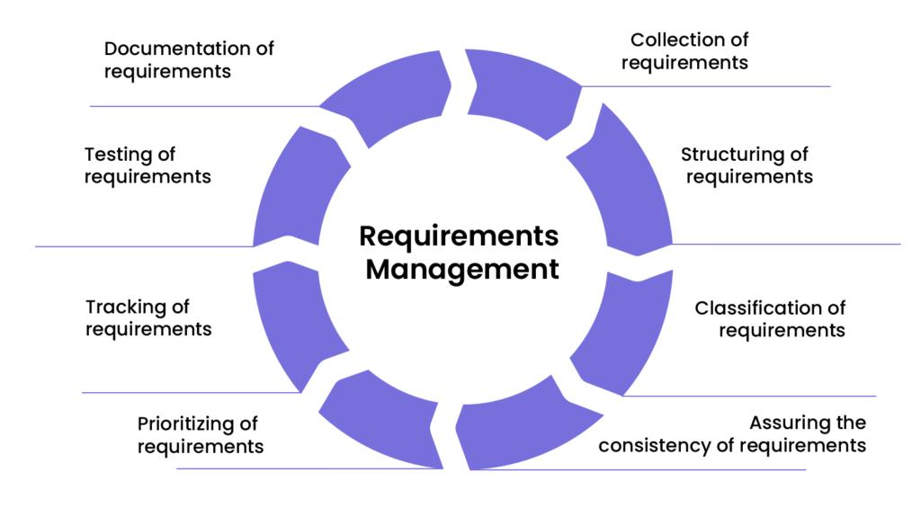
7. Requirements Management
Throughout the project, requirements are managed to accommodate changes, track revisions and ensure that the evolving needs are properly incorporated and controlled.
Figure 4: Requirements Management

Slide 17
Challenges in Requirements Engineering
Challenge | Description | Impact
Incomplete Requirements | Some requirements are missing or not well-defined. | Leads to system failures or unmet user expectations.
Changing Requirements | Requirements evolve due to business, market, or user changes. | Causes rework, delays, and increased cost.
Ambiguous Requirements | Requirements are vague or open to multiple interpretations. | Results in incorrect implementation.
Stakeholder Communication Gap | Misunderstandings between developers and non-technical stakeholders. | Misalignment between product and stakeholder needs.
Lack of Domain Knowledge | Development team lacks understanding of the user’s environment or business. | Results in irrelevant or impractical system functionality.

Slide 18
Scope Creep
Uncontrolled changes in requirements.
Impact: Delays, budget overruns.
Prevention: Clear documentation, approval processes.
Communication Gaps
Between stakeholders and developers.
Causes misunderstandings.
Solutions: Prototypes, regular meetings.

Slide 19
Impact of Poor Requirements in S/W Projects
Inaccurate scope, budget issues.
Failed projects due to misunderstood requirements.
Cause misunderstandings and misaligned expectations.
For example, the FBI Virtual Case File project failed because of vague and incomplete requirements, resulting in a significant budget overrun and eventual cancellation.
Another case is the Denver International Airport's automated baggage handling system, which was plagued by unclear requirements, leading to extensive delays and cost overruns.

Slide 20
Boehm’s Law
According to Boehm's Law, commonly referred to as the Law of Costly Errors, the later a software flaw is discovered in the development lifecycle, the more expensive it is to solution.
To put it simply, it will cost significantly more to fix a bug during testing than it will to cure it during developing and it will cost even more to solve a bug after the software has been deployed.

Slide 21
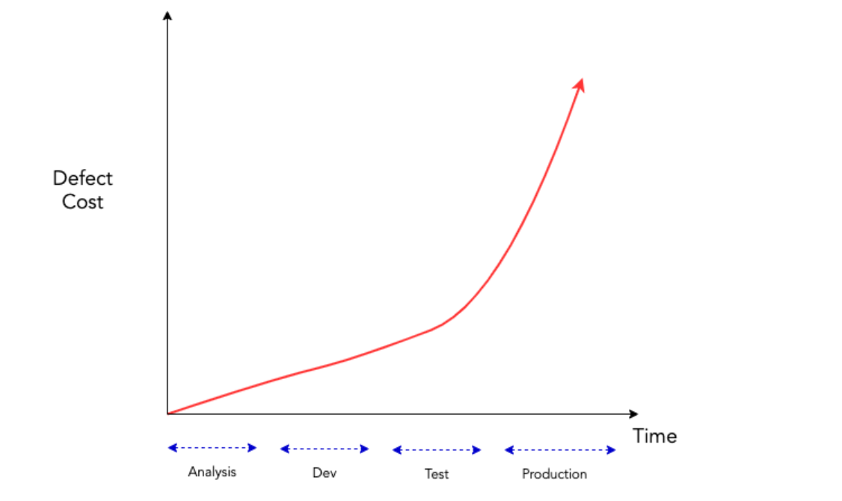
Boehm’s Law (Cont.)

Slide 22
User Stories vs Traditional SRS
User stories: Simple, customer-focused statements.
SRS: Software Requirements Specification.
User Stories | Traditional SRS
1. Simple, informal sentence: “As a [user], I want [feature]…” | 1. Formal, structured document with detailed sections and specifications.
2. User needs and outcomes. | 2. System functionalities and technical details.
3. Iterative, incremental development. | 3. Upfront, comprehensive documentation.
4. Lightweight and minimal (Agile: Scrum, XP etc.). | 4. Heavyweight, exhaustive documentation (Waterfall, V-model etc.).
5. Highly adaptable to change. | 5. Difficult and costly to change once finalized.

Slide 23
The Requirements Baseline
A requirements baseline is a set of requirements that has been reviewed and agreed upon and serves as the basis for further development.
A meaningful baselining process gives all the major stakeholders confidence in the following ways:
Customer management or marketing is confident that the project scope won’t explode out of control, because customers manage the scope change decisions.
User representatives have confidence that the development team will work with them to deliver the right solution, even if they didn’t think of every requirement before construction began.
Development management has confidence because the development team has a business partner who will keep the project focused on achieving its objectives and will work with development to balance schedule, cost, functionality, and quality.
Business analysts and project managers are confident that they can manage changes to the project in a way that will keep chaos to a minimum.
Quality assurance and test teams can confidently develop their test scripts and be fully prepared for their project activities.

Slide 24
Shift-Left Testing
A software testing approach that involves performing testing activities early in the software development life cycle (SDLC), typically during the requirements, design or development phases, instead of waiting until after implementation.
Shift-left testing: Test early; Test before implementation; Test often using requirements.

Slide 25
References
https://datarob.com/essentials-software-development-life-cycle/
https://www.geeksforgeeks.org/software-engineering/functional-vs-non-functional-requirements/
https://dribbble.com/shots/4715049-Requirement-Engineering-Process
https://xebrio.com/what-is-requirements-management-a-complete-guide/
https://www.geeksforgeeks.org/software-engineering/software-engineering-challenges-eliciting-requirements/
https://rnjn.in/glossary/boehms-law/
https://www.atlassian.com/devops/what-is-devops/agile-vs-devops
https://www.agilebusiness.org/dsdm-project-framework/moscow-prioririsation.html

